Slide 1

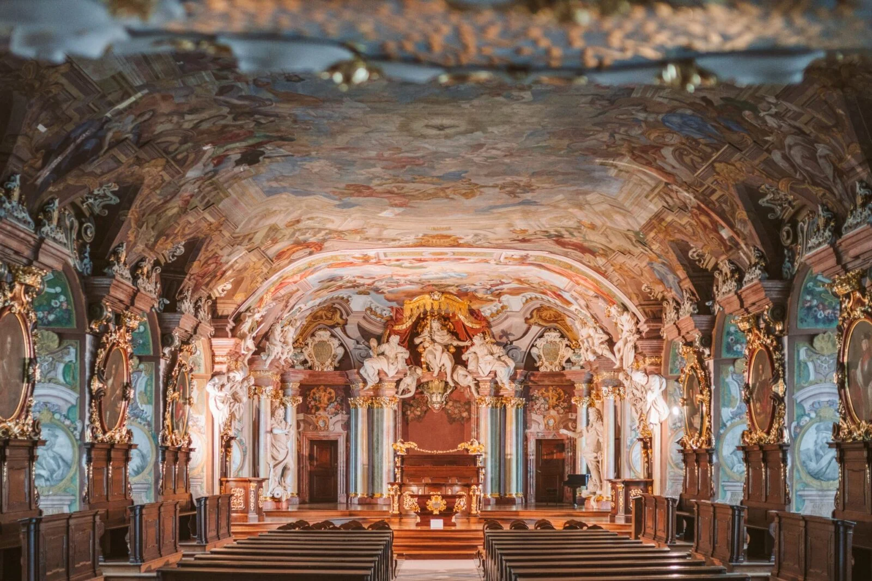
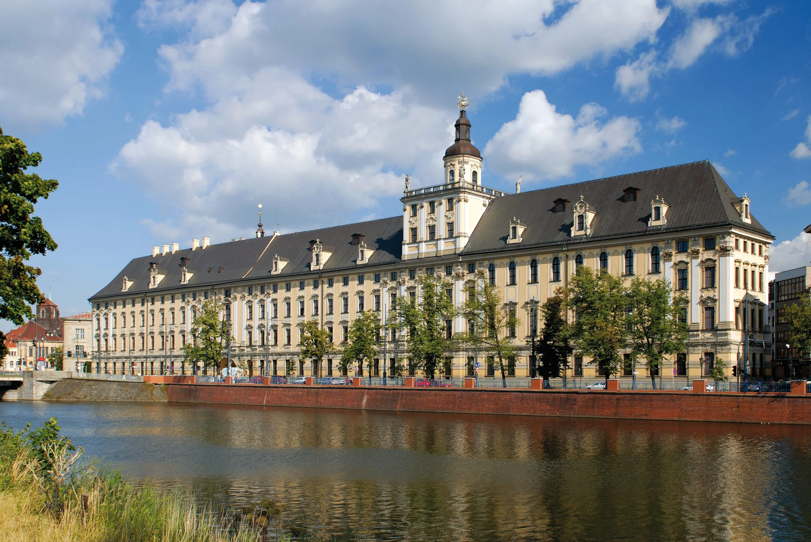

Slide 2

Faculty of Languages, Literatures and Cultures
Institute of English Studies
Institute of Romance Studies
(French, Italian, Spanish, Portuguese)
Institute of Slavic Studies
(Czech, Ukrainian, Serbian, Russian, Macedonian, Croatian)
Institute of Classical, Mediterranean and Oriental Studies
(Latin, Ancient Greek, Modern Greek, Hindi, Arabic, Chinese, Korean)
Chair of Dutch Studies (Dutch, Flemish, Afrikaans)
Chair of Jewish Studies (Hebrew, Yiddish, Sephardic)

Slide 3
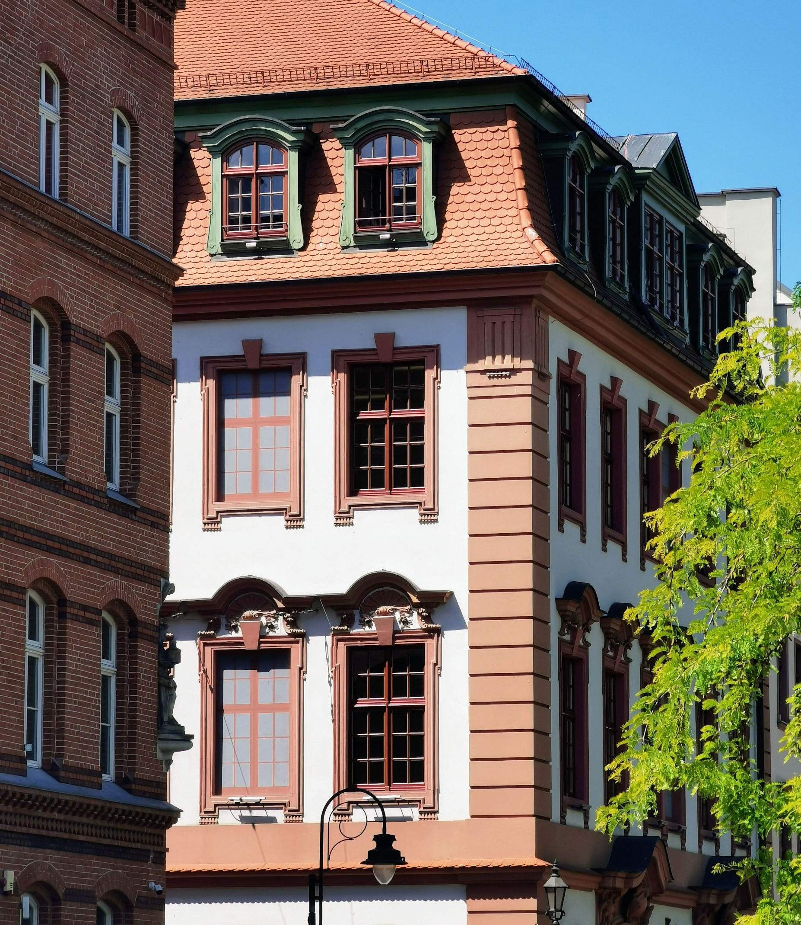
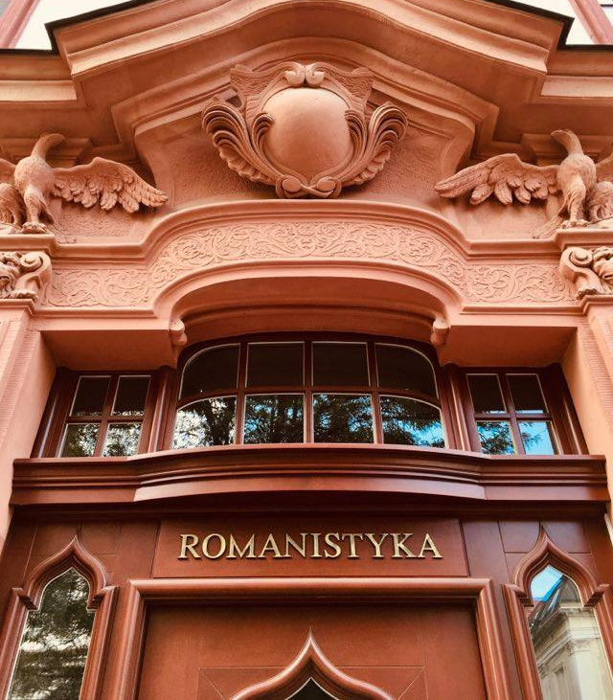
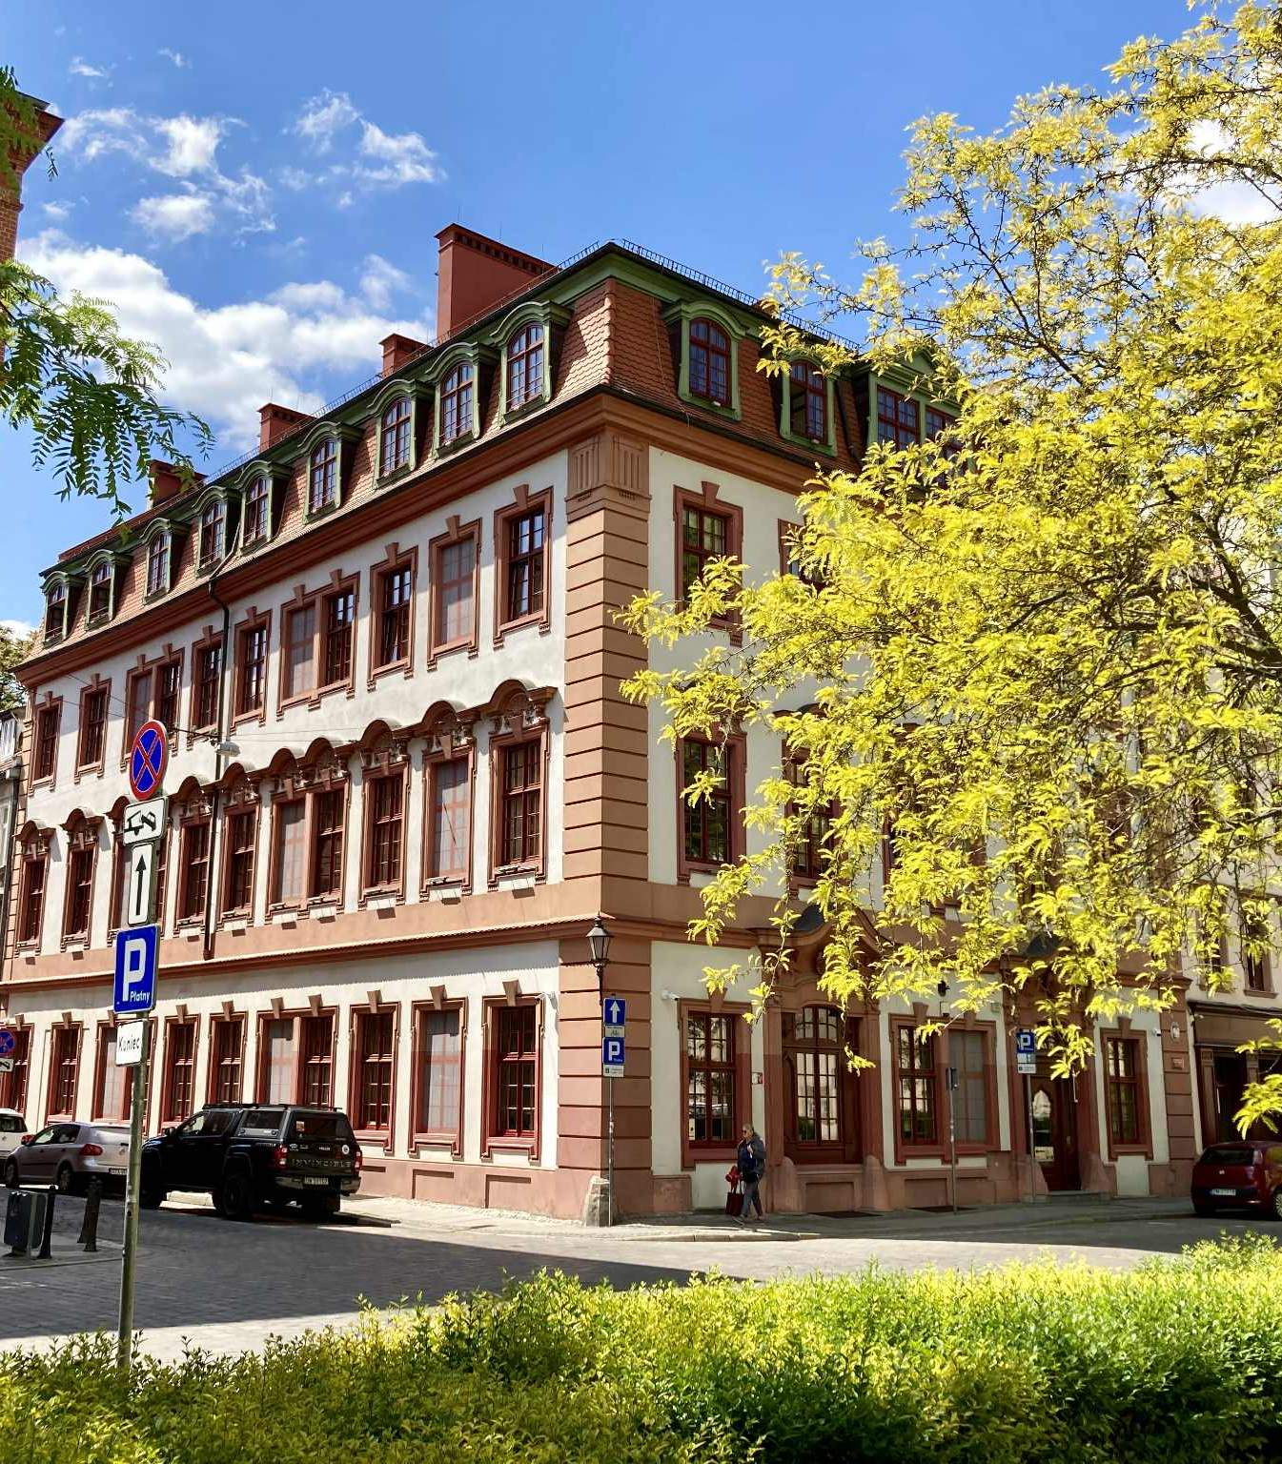
Institute of Romance Studies

Slide 4
Structure of the Institute
French Linguistics
(7 members)
French Literature and Culture
(7 members)
Spanish Literature
and Linguistics
(13 members)
Italian Literature
and Linguistics
(6 members)
Translation [transversal]
(7 members)
Romance Languages Didactics [transversal]
(10 members)

Slide 5
Students
Licence:
French Studies: ~110 students
Spanish Studies: ~100 students
Italian Studies: ~60 students
Master:
Romance Studies
(3 languages combined):
~90 students
Doctorate:
9 PhD candidates

Slide 6
Main research areas
Literature and Culture Studies
- History of Theatre
- History of European Thought
- Children’s and Young Adults’ Literature
- Modern Literature (Sociopoetics, Ecocritics, Gender & Queer Studies)
Linguistics
- Press Discourse
- Generative Linguistics
- Intercultural Communication
- Ethnolinguistics
Didactics
- Informal Learning Techniques
- Modern Didactics of RL
- Plurilingualism in Didactics
Translation Studies
- Terminology
- Audiovisual Translation
- Comparative Lexicography
- Social and Political Aspects of Translation
- Theory of Translation

Slide 7
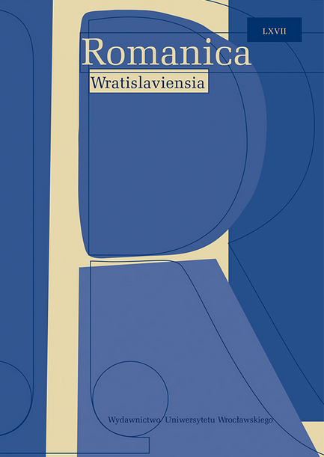
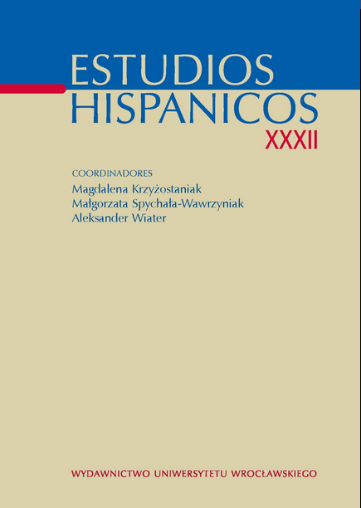
Our Reviews
Romanica Wratislaviensia
Estudios Hispánicos

Slide 8

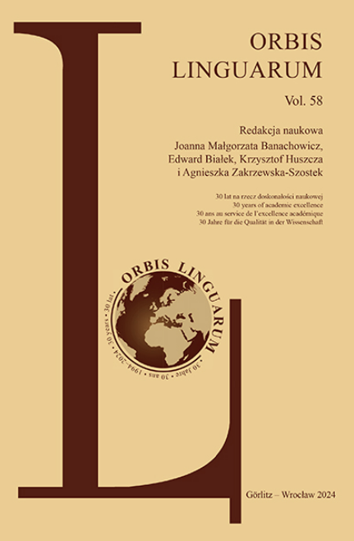
Our Reviews
Italica Wratislaviensia
Orbis Linguarum

Slide 9
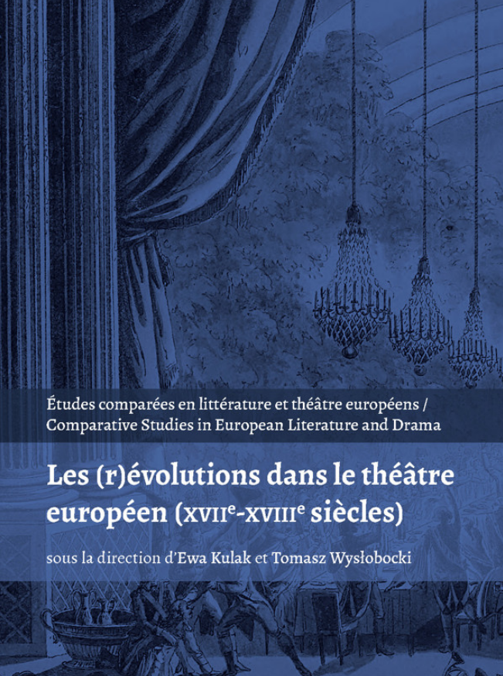
New Brepols Series
Études comparées en littérature
et théâtre européens.
Perspectives de l'Europe Centrale
Comparative Studies
in European Literature and Drama.
Central European Perspectives

Slide 10
Last international conferences
March 2026, „Pour qui traduire? Qui pour traduire?”
May 2025, „Outils et méthodes pour l’enseignement des langues MoDiMEs en milieu universitaire”
November 2023, „Le monde des Lumières – perspectives de recherches interdisciplinaires francophones”
October 2023, „De quelles voix sommes-nous fait.es ? Oralités et discours rapportés. Histoire, formes et pratiques”
December 2022, „La experiencia mística en la cultura y la ciencia”
October 2022, „Les survivances et les racines de Molière”

Slide 11
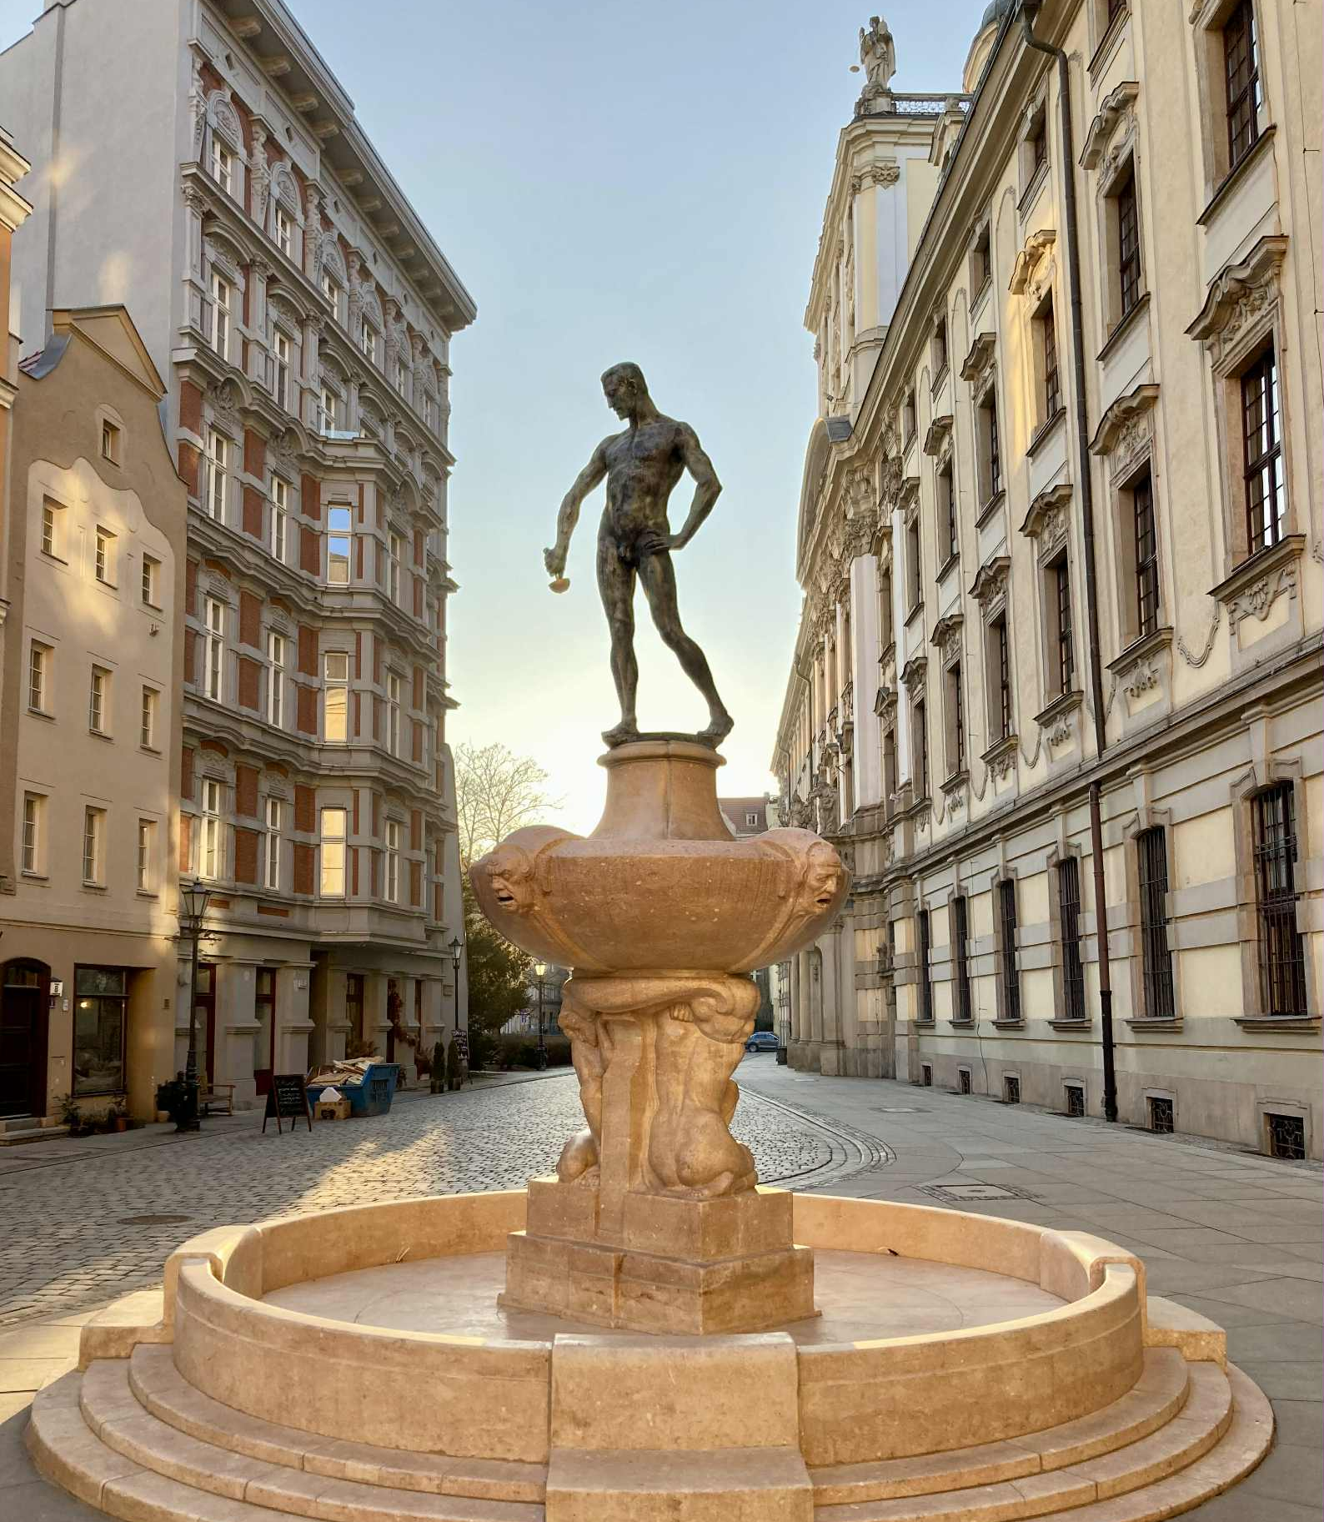
Thank you for your attention!
Dziękuję za uwagę!
Imię Nazwisko
imię.nazwisko@uwr.edu.pl

